Slide 1
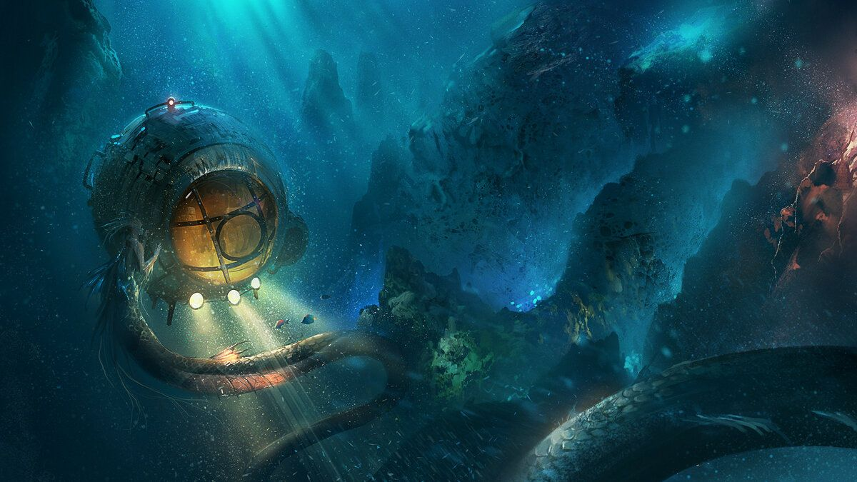
Bathyscaphes : revolutionary explorers
By IU5-32B Student:
Kudabaeva Evita

Slide 2
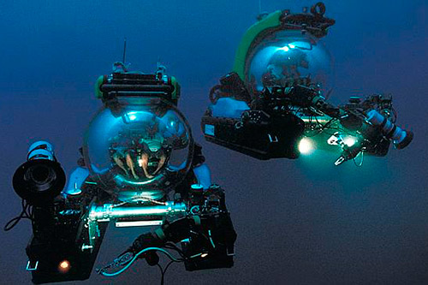
Definition
A Deep-Sea Submersible
Bathyscaphes — free-diving submersibles designed to reach extreme ocean depths.

Slide 3
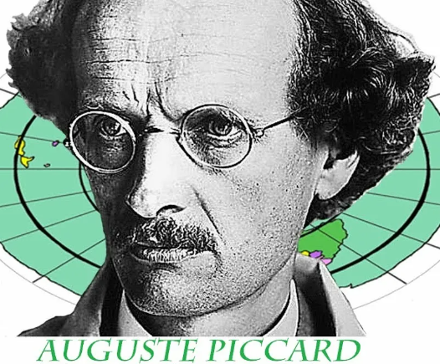
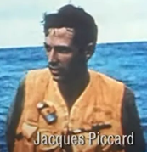
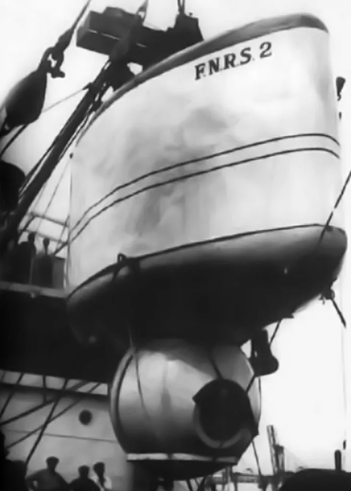
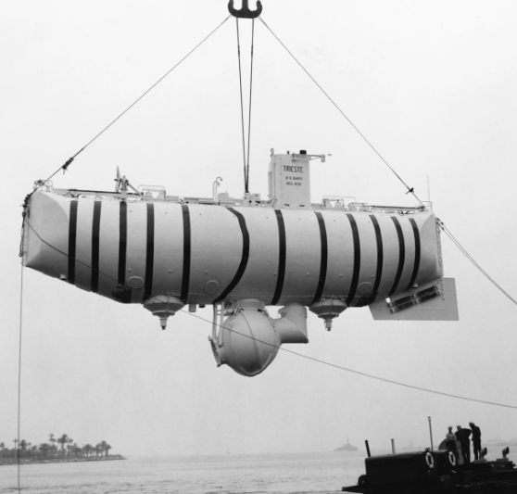
The history of creation
The Swiss physicist Auguste Piccard invented the bathyscaphe.
He had already pioneered high-altitude balloon flights in the 1930s, and applied similar principles of a pressurized cabin and buoyancy to deep-sea exploration.
The first bathyscaphe, FNRS-2, was built in Belgium and launched in 1948.
Piccard and his son, Jacques Piccard, built the second bathyscaphe, the Trieste, in Italy.

Slide 4
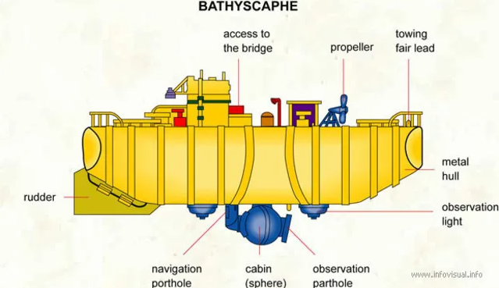
Key Components and Structure

Slide 5
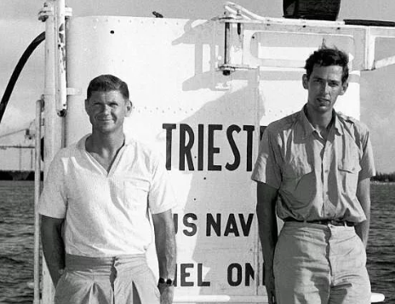
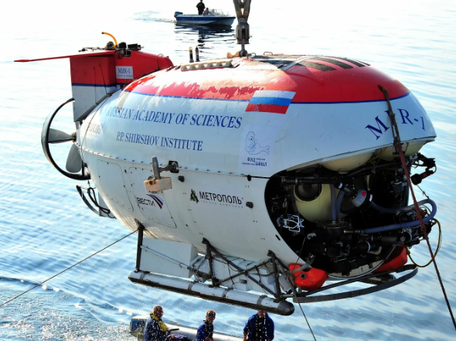
Milestones
In 1960 Jacques Piccard, along with Don Walsh of the US Navy, piloted the Trieste to the deepest point in the ocean, the Challenger Deep in the Mariana Trench (~ 11 km!).
Mir (Russian: Мир, lit. 'world, peace’) —a class of two self-propelled deep-submergence vehicles.
The project was initially developed by the USSR Academy of Sciences along with Lazurit Central Design Bureau, and two vehicles were ordered from Finland.
The Mir-1 and Mir-2, delivered in 1987, were designed and built by the Finnish company Rauma-Repola's Oceanics subsidiary.

Slide 6
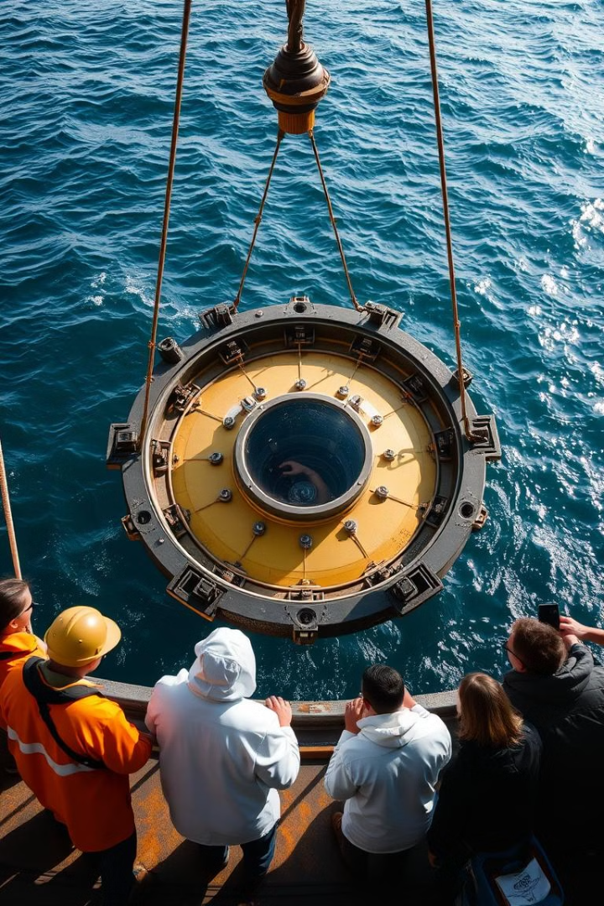



The Importance of the creation
Exploration
Bathyscaphes opened up the deep ocean to
exploration, revealing its mysteries.
Scientific Advancements
They facilitated groundbreaking research on marine life, geology, and oceanographic processes.
Technological Innovation
The development of bathyscaphes spurred technological advancements in materials and engineering.

Slide 7
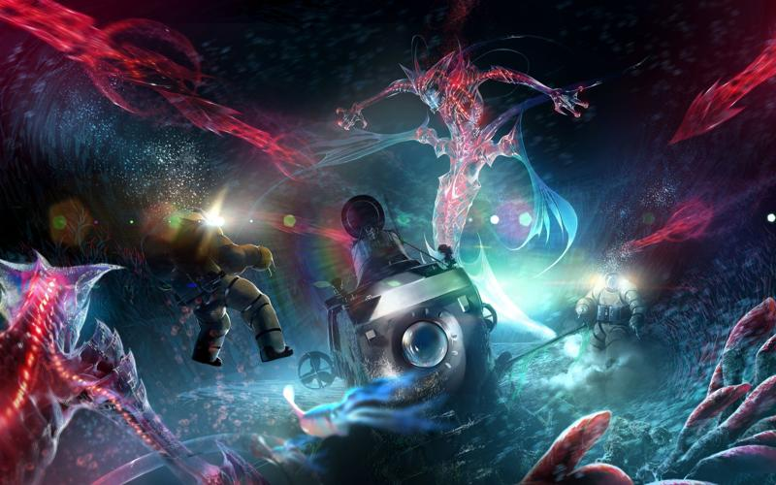

Advantages and Disadvantages
Advantages
High depth capability, maneuverability, and the ability to stay submerged for extended periods.
Disadvantages
Limited space, slow speed, and dependence on complex support systems.

Slide 8
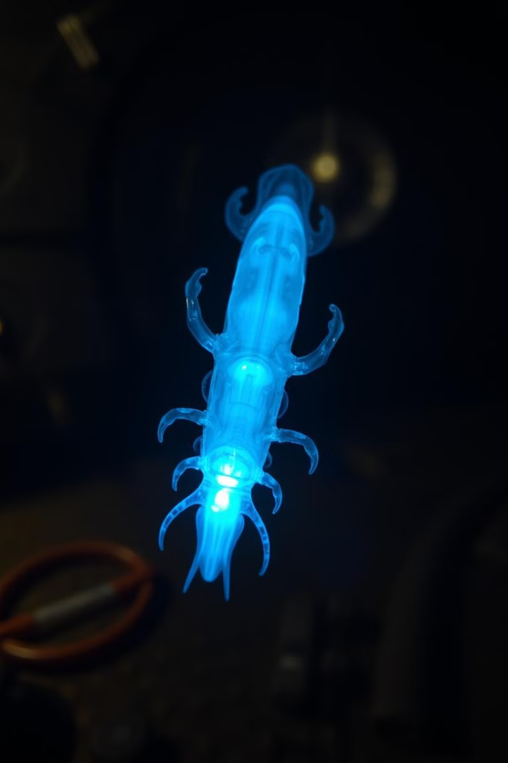
Scientific Discoveries
1
New marine life forms, including deep-sea fish, invertebrates, and microorganisms.
2
Detailed information on hydrothermal vents and their ecosystems.
3
Insights into the geological structure and composition of the ocean floor.

Slide 9
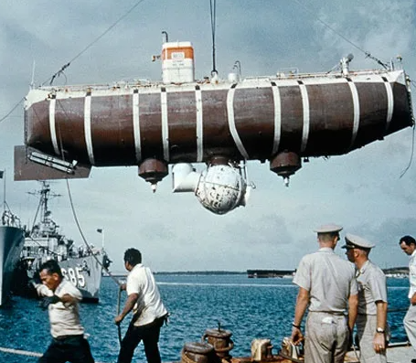


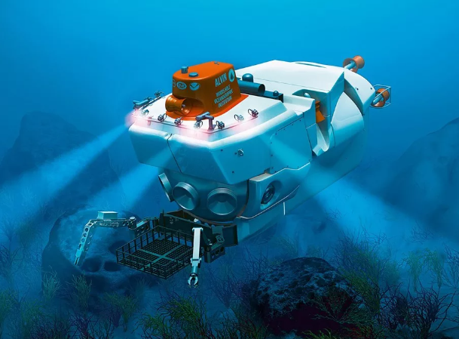
Old to New Models
Early Models
Simple design with a pressure sphere
and flotation tanks.
Modern Submersibles
Advanced design with improved maneuverability, technology, and safety features.

Slide 10
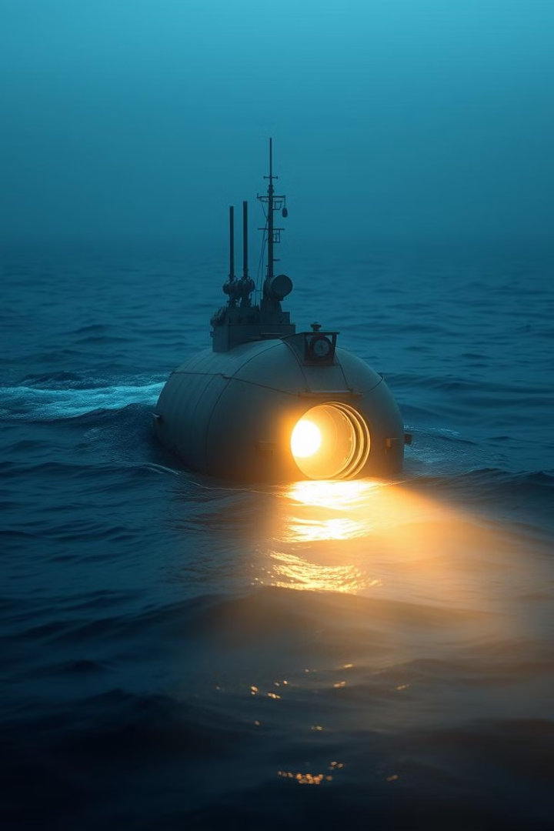
Contribution to Undersea Exploration
Bathyscaphes have played a crucial role in revolutionizing our understanding of the deep ocean.
Their contributions to science, technology, and exploration continue to inspire awe and wonder as we venture into the unknown depths of our planet.

Slide 11

Thank you for your attention!

